Slide 1

Project Title :--
Multiplayer Game using Python, Pygame

Slide 2
Purpose of our project
Our project is all about a multiplayer concept related 2D game where we
Have tried to present a game in only a single device with the continuation
Of multiplayer tag.
Purpose of our project is to make a multiplayer game in that should
Be chip memory consumer and make a multiplayer game which
Should be single device related.

Slide 3
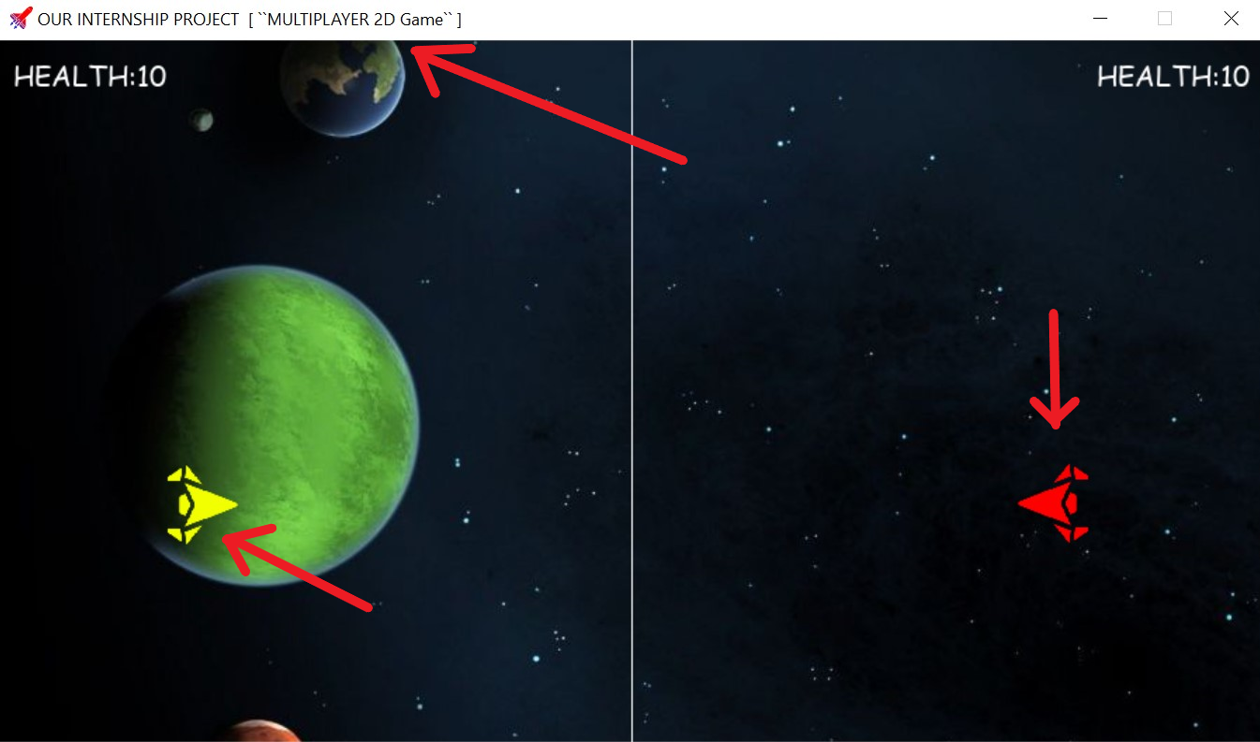
Project Title
Player 2
Player 1

Slide 4
Functions defined in this project :--
Initialization part.
Implementation of all the initialization in the window.
Player movement.
Handle bullets and draw the winner.
Defining the main fuction.
Implementation of the function.

Slide 5

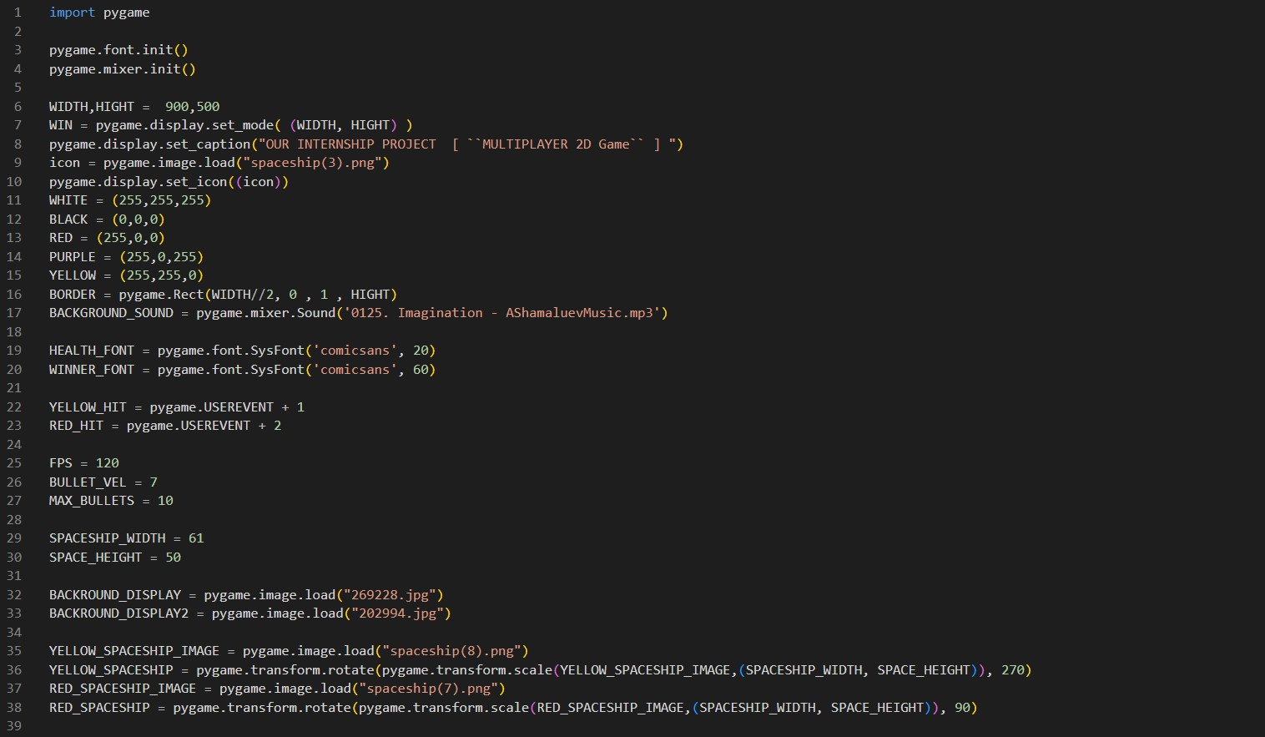

Slide 6
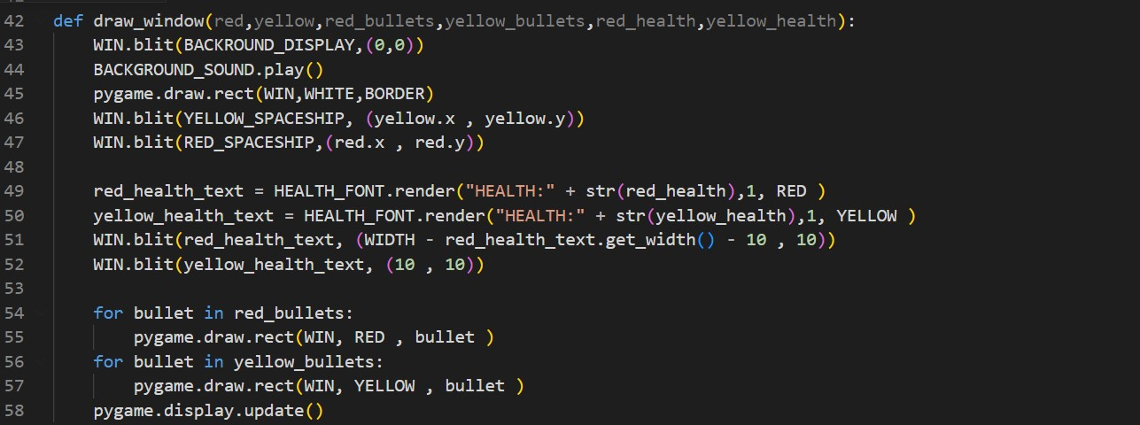

Slide 7
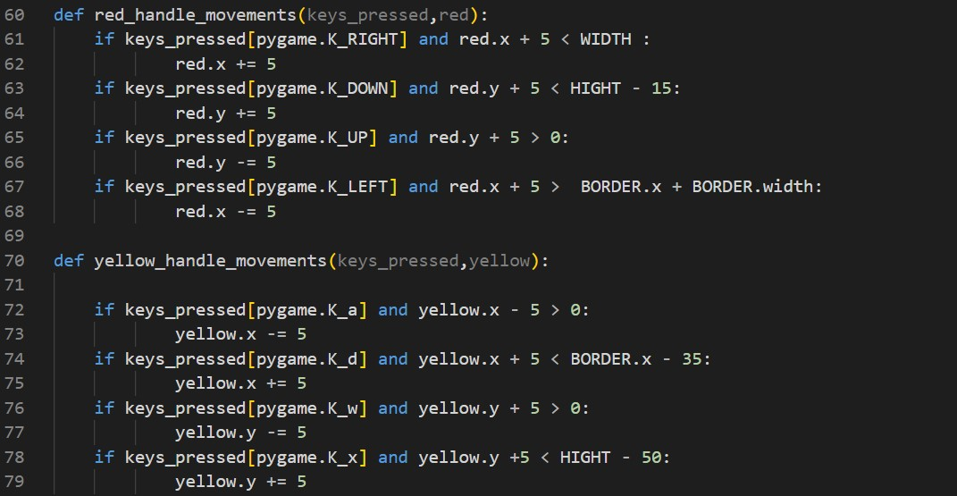

Slide 8
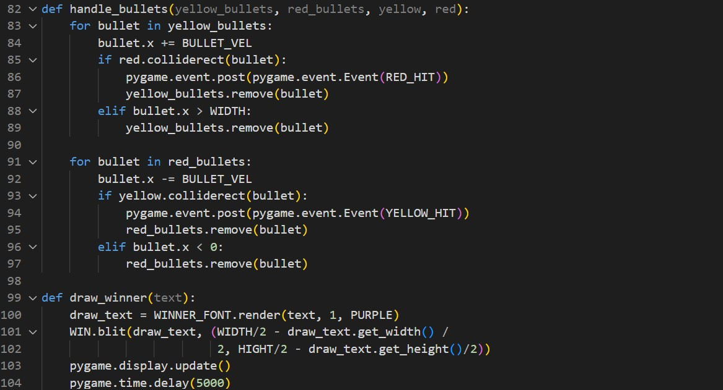

Slide 9
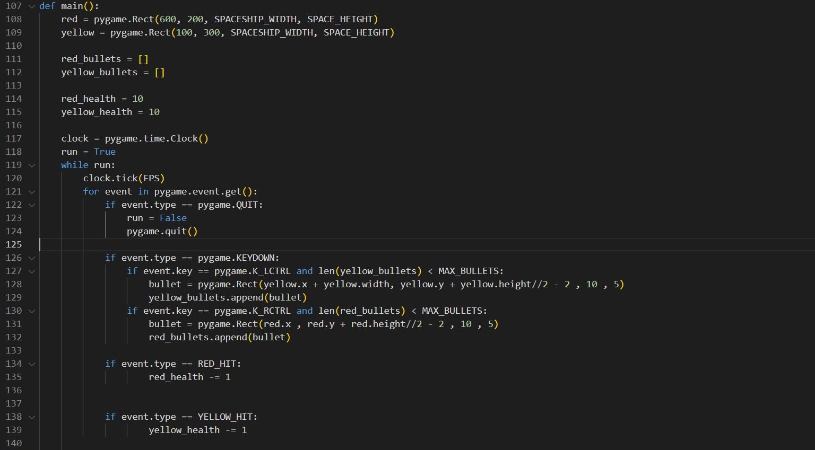

Slide 10
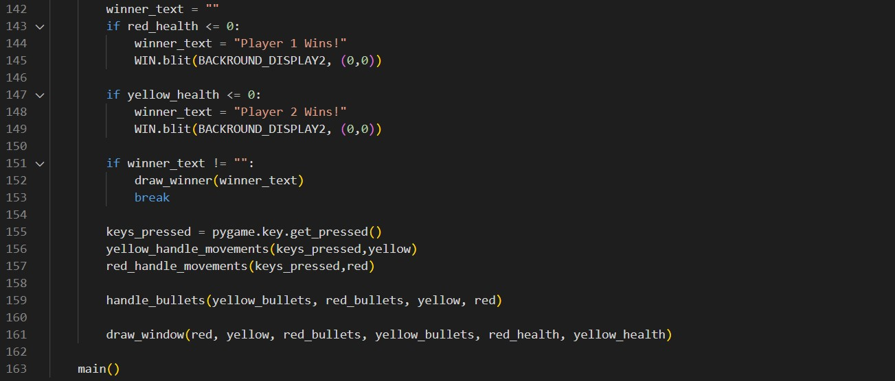

Slide 11


